Slide 1
Predictive Learning a Self Model: The Genesis of Symbolic Cognition?
Randall C. O’Reilly
University of Colorado Boulder
eCortex, Inc

Slide 2
Goals to Symbols
Goal-driven (ends-driven / teleological) inverse model learning to select actions based on outcomes (age ~2-4)
Metacognitive model of the self is learned through predictive learning of self / other behavior (I am what I do) (age ~5+)
Symbolic cognition emerges from goal-driven metacognitive control of the self: I learn to flexibly activate desired outcomes by mentally simulating my self model

Slide 3
Goals drive Learning
We can hand-train models to do all the elements of symbolic cognition (neural production system in PFC / BG).
What is always missing are the learning signals to shape / improve this system in the first place.
We learn problem solving because we actually have real problems we want to solve (i.e., goal states we can’t yet achieve).
Goals are like predictions = source of error signals

Slide 4
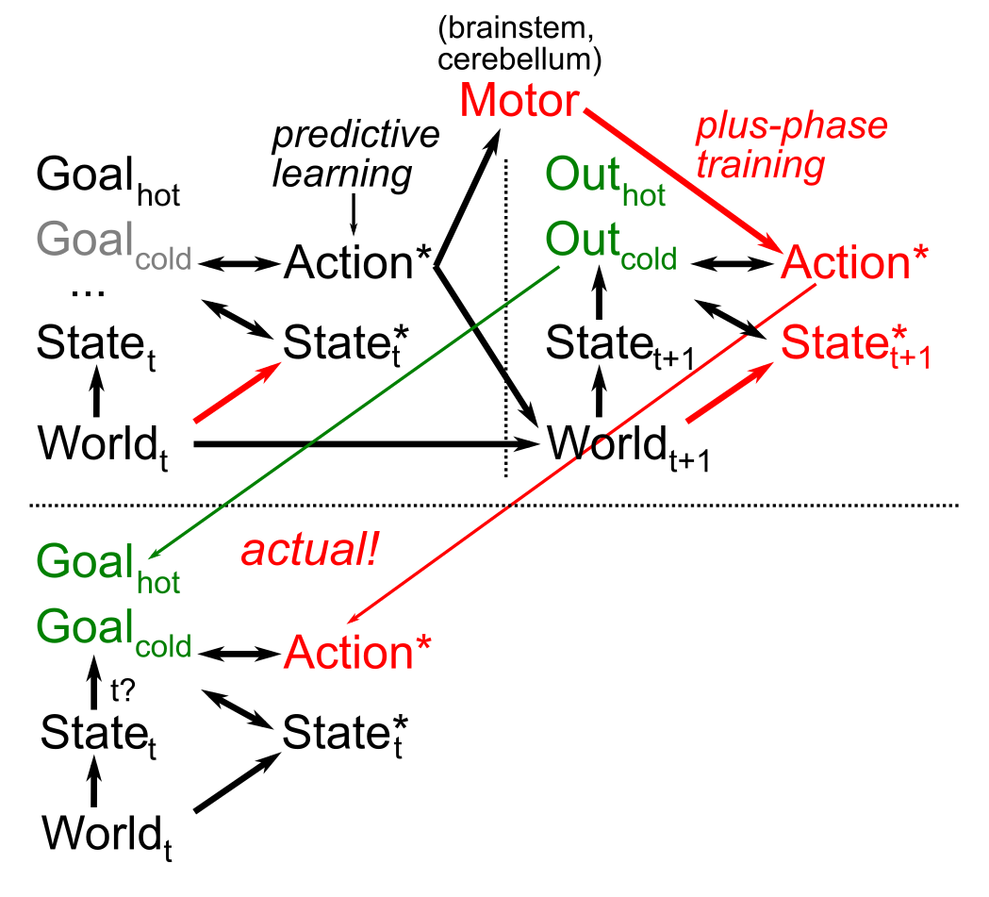
Goals, Motor Modeling
How to turn
action -> outcome
into
desired outcome
-> action?
Not as easy as it might sound..
Same predictive learning mechanisms applied to forward and inverse sensory-motor learning.

Slide 5
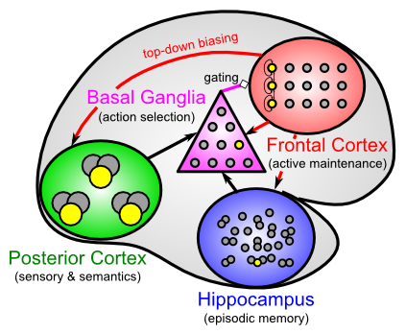
Leabra Biological Architecture
PC is parallel
BG / FC enables serial via gating and active task maintenance
Hippo is fast, high-capacity memory cache

Slide 6
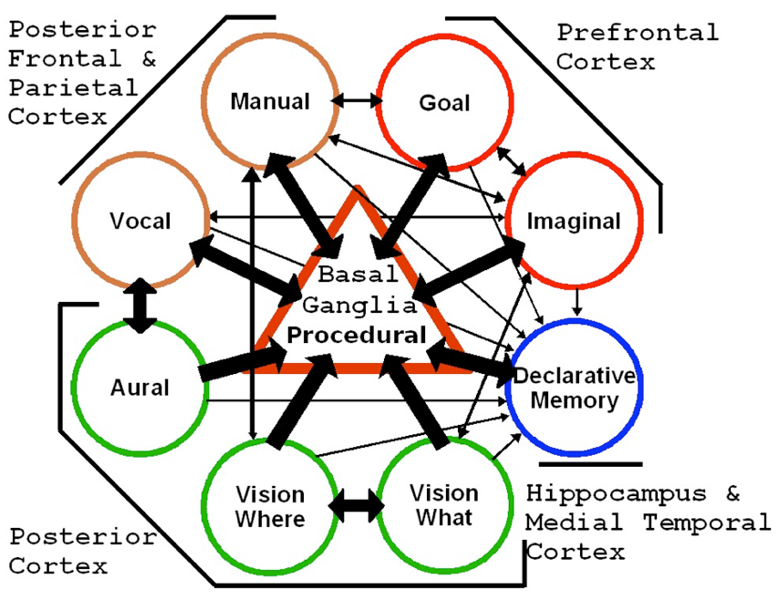
SAL: Synthesis of ACT-R & Leabra
BG production system forces serialization -> flexible combination of productions. Goal buffer & declarative memory coordinate.

Slide 7
Parallel vs. Serial
Turing machines are universal because they are serial (and it doesn’t take much hardware)
Conversely, some (large class of) problems cannot be solved in parallel (dependencies..)
To achieve universal flexibility, inherently parallel neural processing must support serial mode

Slide 8
More Serial Advantages
Solving novel tasks requires novel combinations of existing subroutines (or new subroutines, which is much harder)
Serialization allows generic recombination of subroutines.
Parallel processing requires separate hardware for each routine, and connecting them is tricky..

Slide 9
Parallel is great too..
Fast, high-dimensional constraint satisfaction
Parallel gradient search learning: pursue many different solutions in parallel (serial search takes until the end of the universe..)
The human brain is the best known combination of parallel and serial processing! (animals are too parallel)

Slide 10
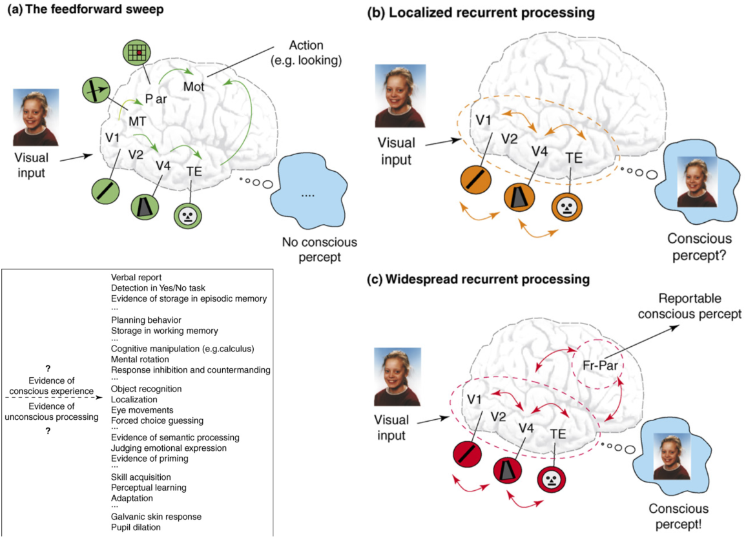
Lamme, 2006

Slide 11
PBWM System (bio LSTM)
Three levels of modulation to get anything done..

Slide 12
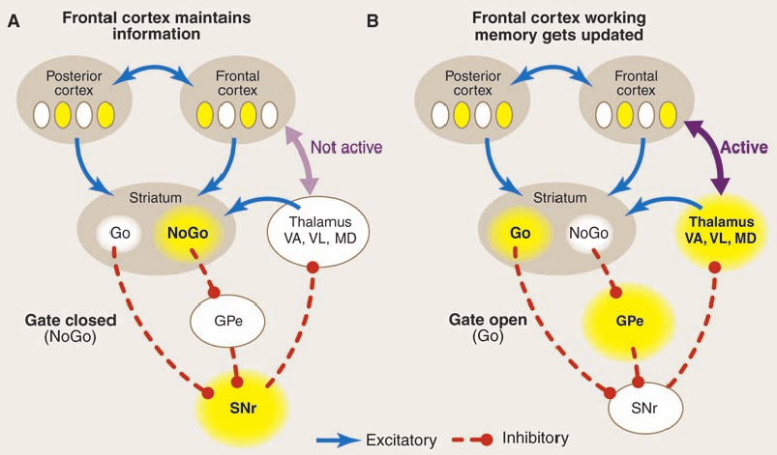
Dynamic, Adaptive Gating (BG)
BG Toggles PFC bistable states

Slide 13
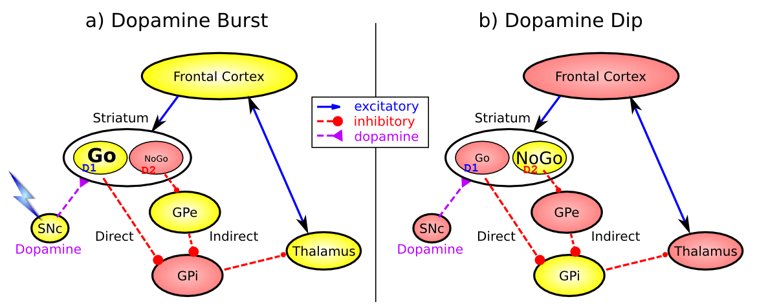
Basal Ganglia Reward Learning (Frank, 2005…; O’Reilly & Frank 2006)
Trial and error learning: action of updating PFC is evaluated in terms of previous success associated with PFC state

Slide 14
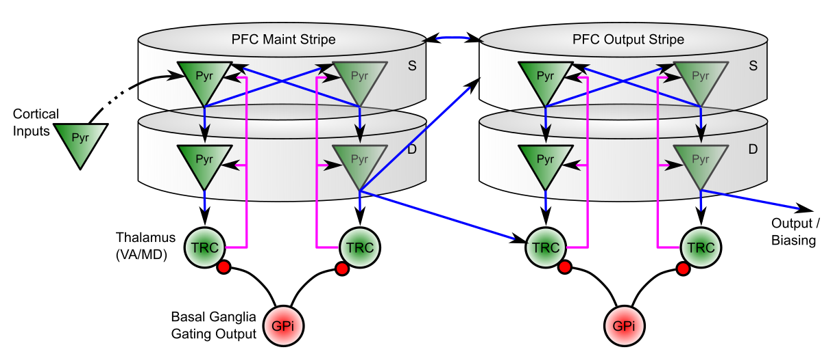
BG Gates Super -> Deep
Maintenance via Thalamocortical loops (TRC <-> Deep), BG disinhibits
Superficial reflects inputs and maintenance
Separate Maintenance vs. Output PFC / BG stripes

Slide 15
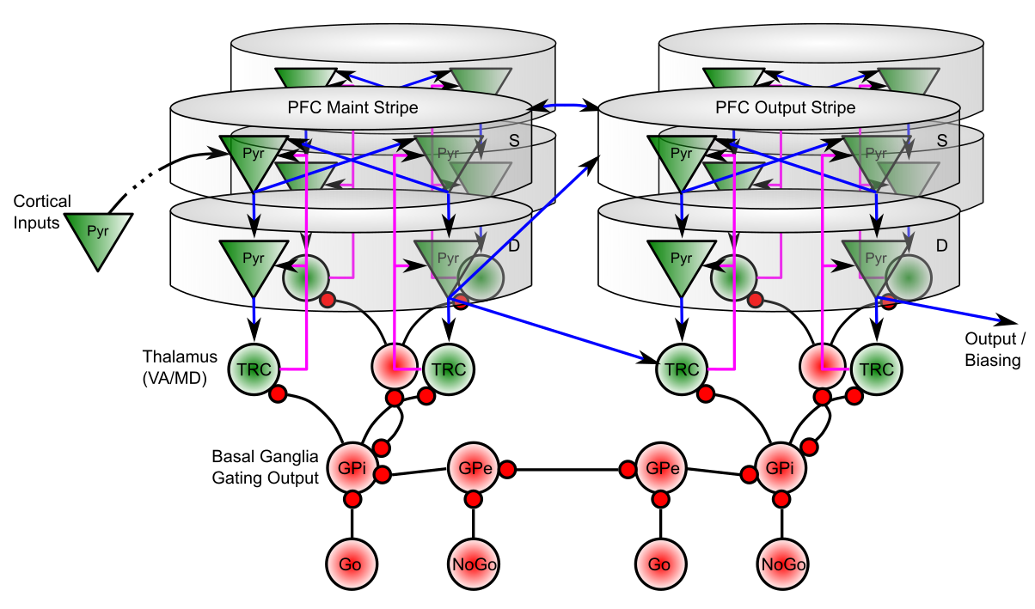
BG Gates Super -> Deep
Competition in GPi, GPe (and striatum) between Maint vs. Output, and diff stripes
Pre-competition in GPe for NoGo veto power (cannot veto everything!)
Asymmetric learning rate for dopamine dips vs. bursts on NoGo (D2) – hypercritical..

Slide 16
PBWM Applications
Learns from raw trial & error experience to perform complex working memory tasks, including N-Back (Chatham et al, 2011), 1-2-AX CPT (O’Reilly & Frank, 2006), Keep Track (Friedman et al, in prep)
Role of BG and DA on working memory tested in a number of expts (e.g., Frank & O’Reilly, 2006)

Slide 17
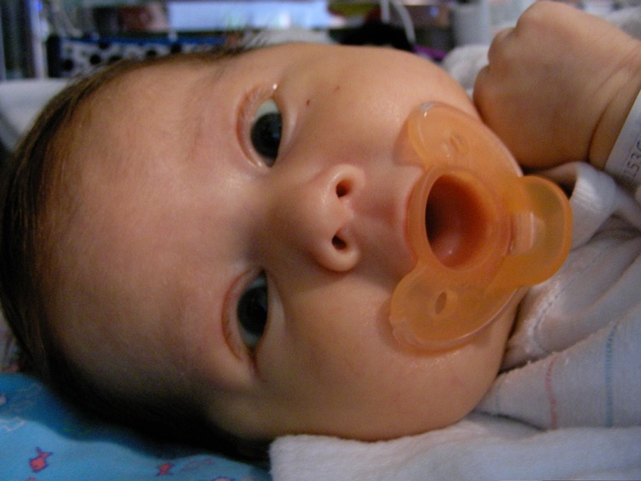
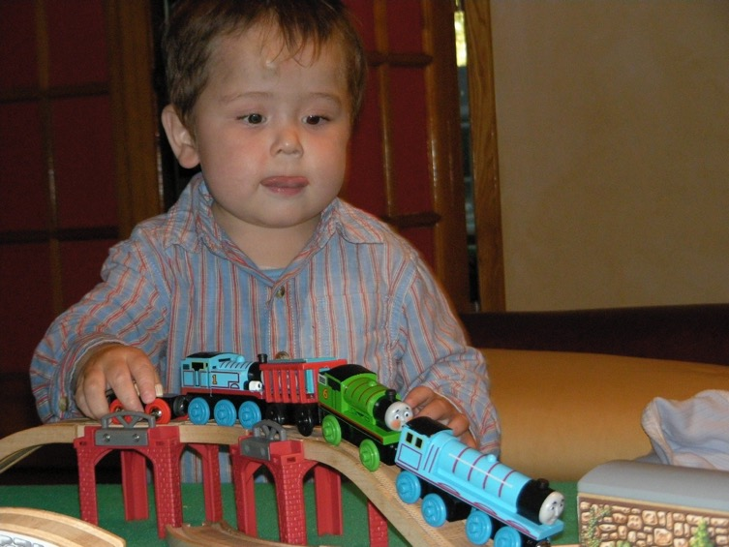
The Mystery of (Knowledge) Development
The first ~6 months: passive, but intent, staring at the world moving by..
And yet, so much is learned: the foundation for everything we know..
How does this happen!?

Slide 18
Invariant Object Recognition is Hard
Different objects in same location share many features
Same object in different locations shares NO features
Hebbian: “fire together = wire together” – exact opposite!

Slide 19
Deep Convolutional Neural Nets
Solve the invariant recognition problem; high performance,
but dependent on huge datasets of hand-labeled images
Baby does not have access to these labels!
(and monkey certainly doesn’t!)

Slide 20
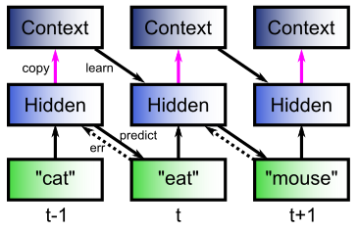
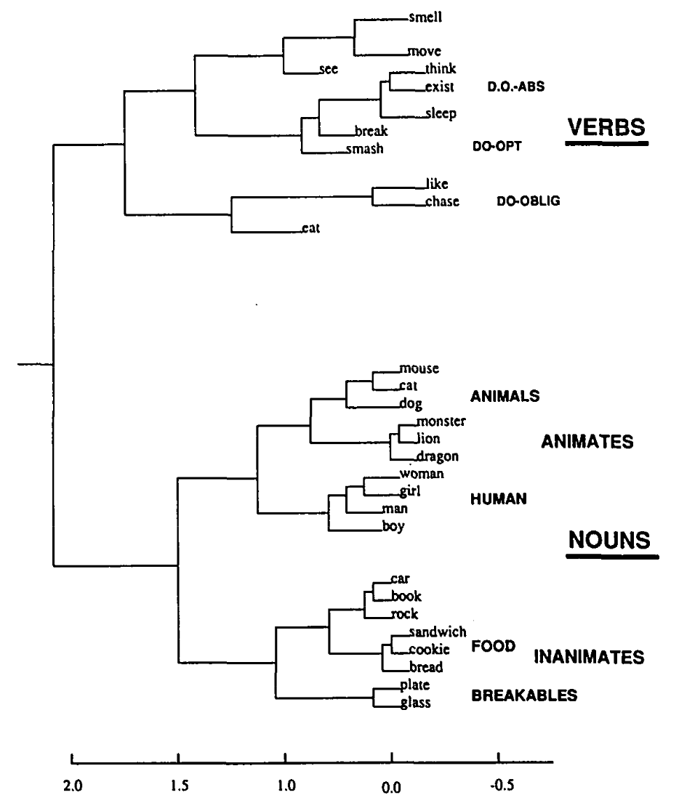
The Predictive Bootstrap (Elman 1990; Elman, Bates, et al. 1996)
Learning to predict words induces verb vs noun category representations in hidden layer of SRN
The future is free!
If you can predict it, you know it!

Slide 21
Predictive Models: use model inferred on prior sensory input to predict next sensory input vs.
Generative Models: typically iteratively infer model from current sensory input, and then “predict” that same sensory input.

Slide 22
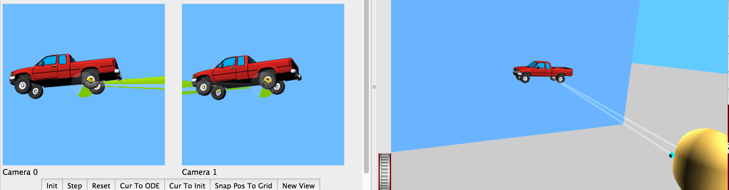
Predictive Vision
Desirable difficulty of predictive learning:
physics, optics, “core knowledge”
No need for hand labeled data (the future is free!)

Slide 23
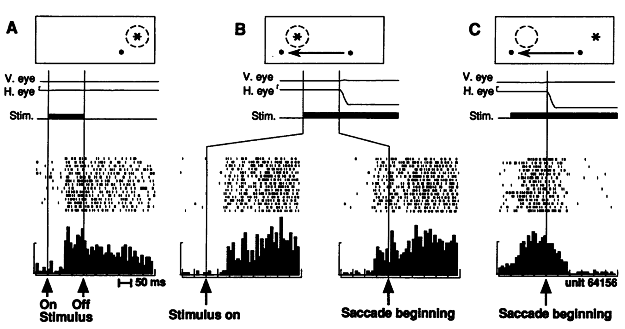
Predictive Remapping Duhamel, Colby & Goldberg (1992)
LIP neurons anticipate effect of saccade, start firing for new location before fixation lands (even before saccade starts!)

Slide 24
Central Hypotheses
Error-driven learning from diff between prediction and what happens next
Prediction – outcome cycle = 100ms = 10hz = alpha
Cortical deep layers drive prediction on Pulvinar
Layer 6CT neurons drive prediction
5IB (alpha burst) from lower layers drive outcome
Error is temporal diff, broadcast fm pulvinar
Local temporal-diff learning throughout cortex

Slide 25
The Pulvinar = Projection Screen (c.f. Mumford, 1991 “blackboard”)
Pulvinar receives connections from all over visual cortex
and projects back out to these same areas
Two qualitative inputs:
1. Few strong driving inputs – feedforward
2. Many weaker feedback “modulatory” connections
Pulvinar!

Slide 26
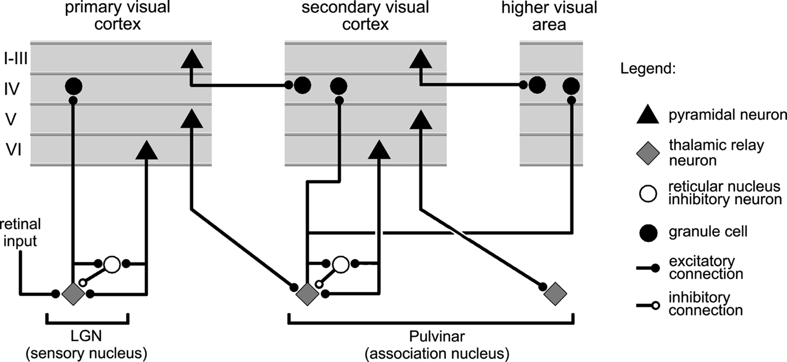
Thalamocortical Loop Biology (Sherman & Guillery, 2006)
5IB
FF
Driver
Weak
FB
What is function of strong feedforward driver vs. weaker feedback pathway?

Slide 27
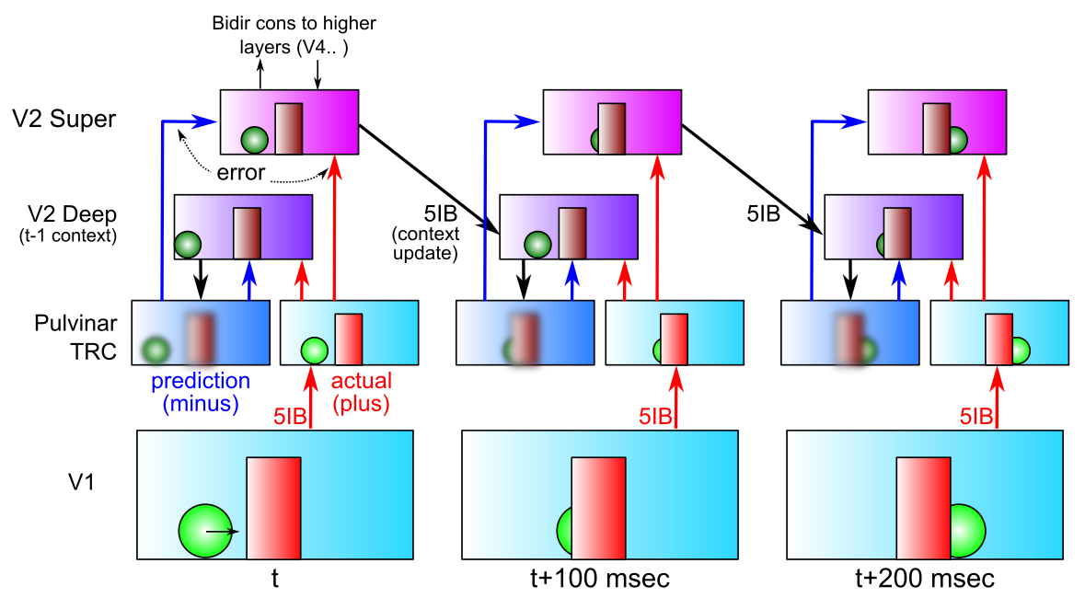
DeepLeabra Predictive Learning
- Deep neocortical layers generate prediction using prior context (SRN)
- Activate Pulvinar with prediction in minus phase (first 75 msec)
- V1 5IB (intrinsic bursting, at alpha) drives plus phase (last 25 msec)
- Error-driven learning on temporal difference improves prediction

Slide 28
DeepLeabra Problems and Solns
- Always represent / process the current input: superficial layers
- Yet force system to make a true prediction (“about the future”):
deep layers, cutoff from current input, rely on prior context
- Error signal available to everyone, everywhere: temporal difference
much simpler than explicit error-coding; integrates all forms of error

Slide 29
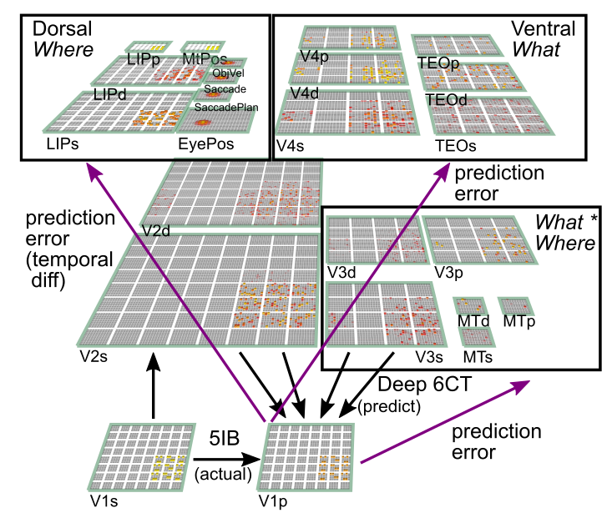
What-Where-Integration Model (O’Reilly, Wyatte & Rohrlich, under revision)
3 Separable pathways
Where develops first using location blobs
What*Where needed for binding two streams
What takes longest, requires other errors to be factored out first
Pulvinar is shared projection screen for predictions
Predicts next visual input at 100 msec (10hz, alpha) frequency
Pulvinar

Slide 30
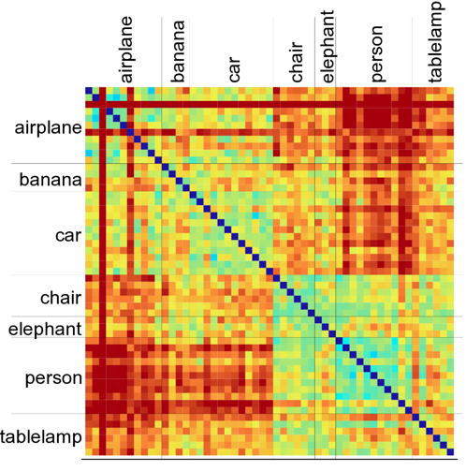
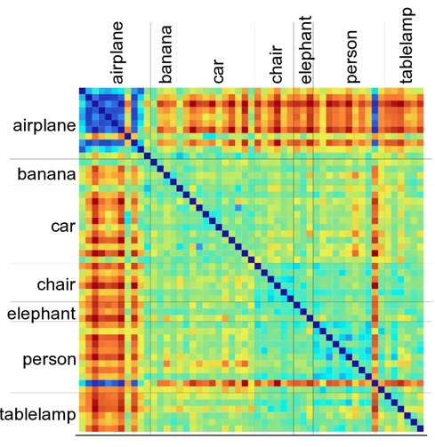
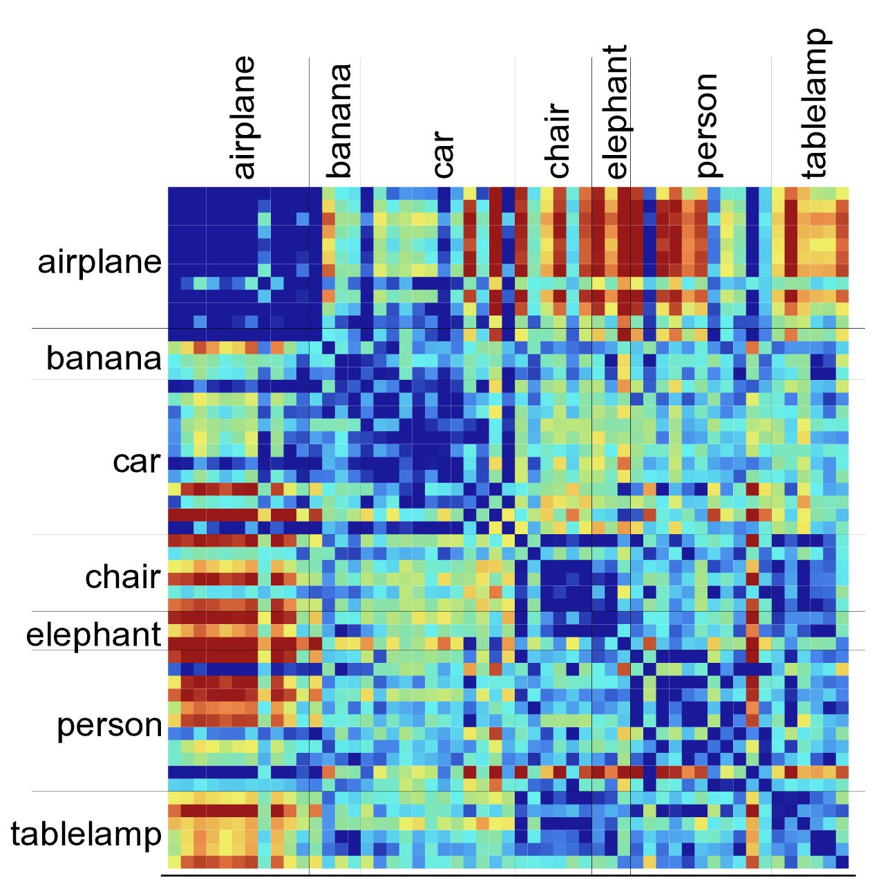
IT Learns Invariant Categories
V1
V4
TE (IT)
Clear enrichment of categorical similarity up the “What” hierarchy: TE is much more “binary” and strongly groups items together.
Completely unsupervised: all prior results depend on extensive training with hand-labeled categorized data. Our model is discovering its categories on its own.
Real brains have much higher dimensional, multi-modal inputs to shape categories..

Slide 31

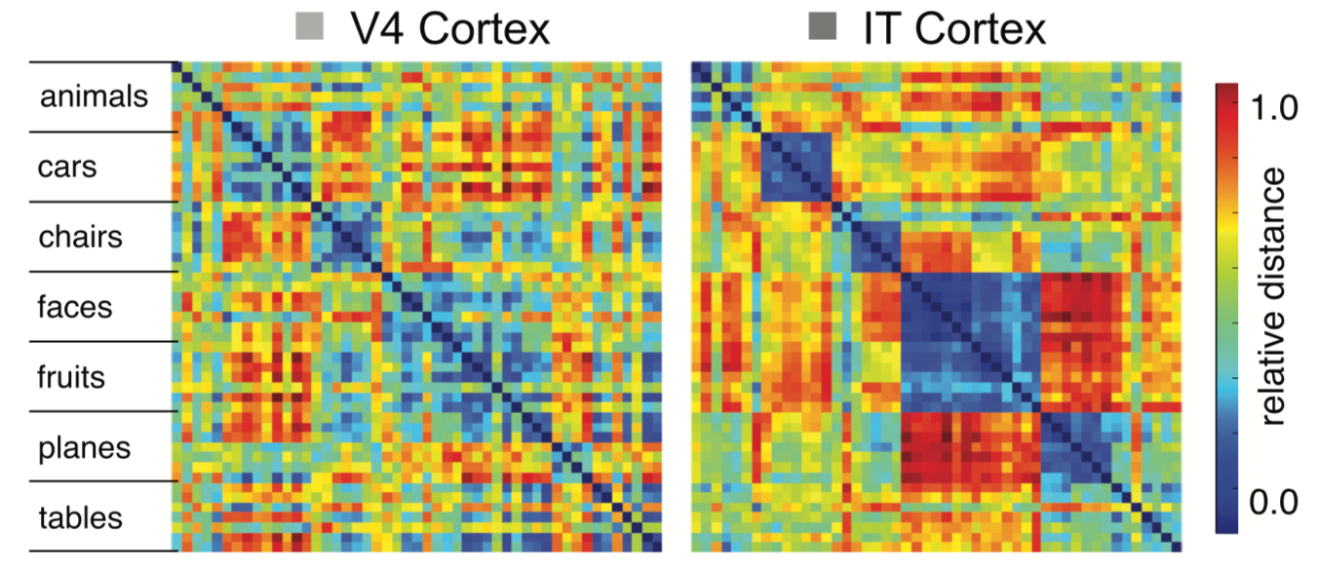
Compares Qualitatively with IT Data
V4
TE (IT)
Model results:
IT forms more consistent, invariant categorical representations
Cadieu et al, 2014 (DiCarlo lab)
Data from macaque

Slide 32
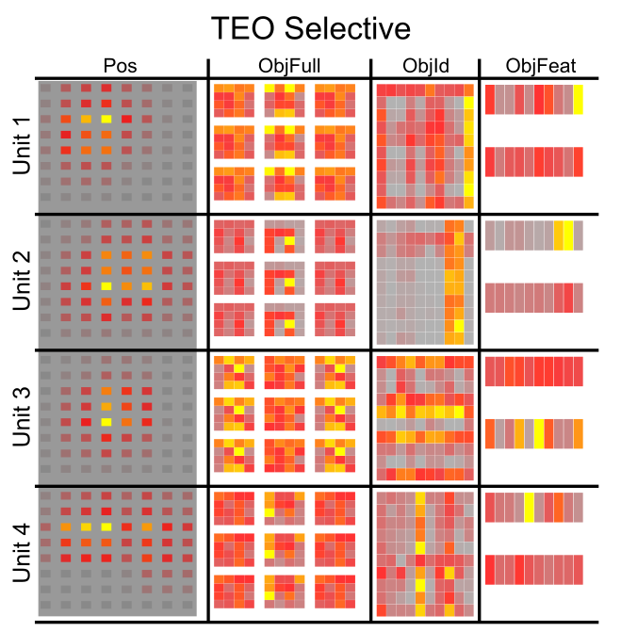
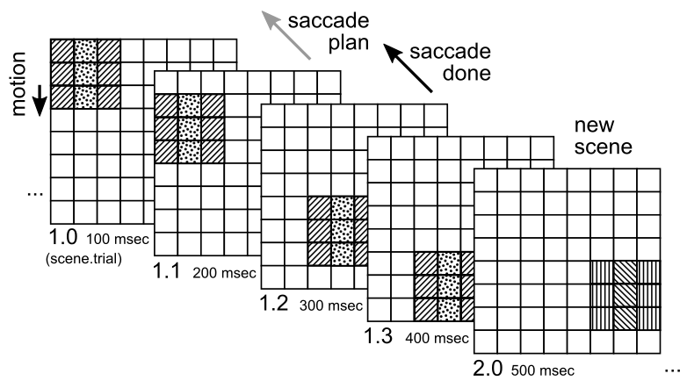
Combinatorial Representations
Objects systematically composed of independent “stripe” features – IT learns these stripes
IT can self-organize low-dimensional, systematic, combinatorial features

Slide 33

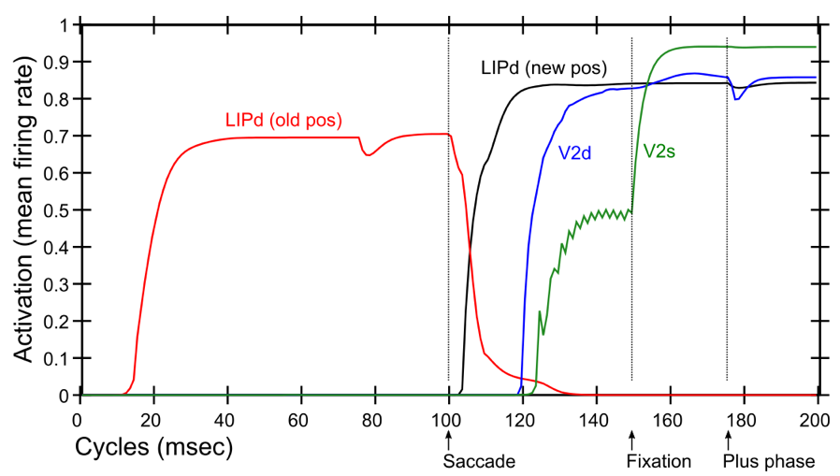
Predictive Remapping
Duhamel et al. (1992):
LIP neurons anticipate effect of saccade, start firing for new location before fixation lands (even before saccade)
Model:
LIPd remaps first at high, abstract level, drives top-down remapping in lower areas – consistent with Cavanagh et al. (2010)

Slide 34
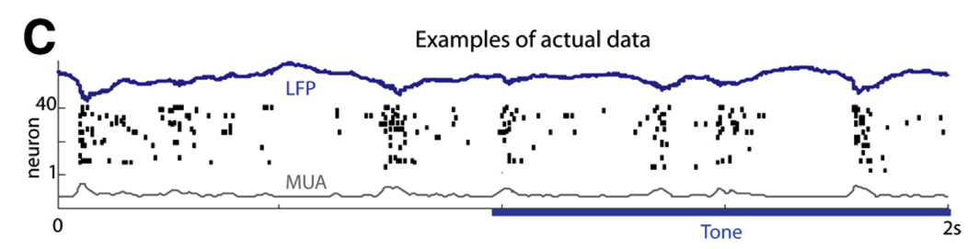
Key Biological Data
Strong, synchronized, low-frequency modulation of cortex (at the alpha frequency).
Specificity of alpha modulation to deep layers & thalamus, not superficial layers.
Nature of deep-layer connectivity to pulvinar: numerous, weaker, plastic pathway (for generating a prediction) and sparse, strong, fixed pathway (for ground truth target).
Synchronization of this strong pathway input with the alpha cycle.
Broad connectivity of pulvinar with different visual pathways (afferent and efferent).
Lack of direct bottom-up superficial projections into the deep layers (would short-circuit prediction), but presence of these projections top-down (beneficial).
Bidirectional (top-down and bottom-up) connectivity between superficial layers.
Early development of the Where (MT, LIP) pathway.
Organization into three separable (yet highly interconnected) visual pathways, particularly a third putative What*Where integration pathway.
(Buffalo et al., 2011; van Kerkoerle et al., 2014; Shipp, 2003; VanRullen & Koch, 2003; Luczak et al., 2013..)

Slide 35

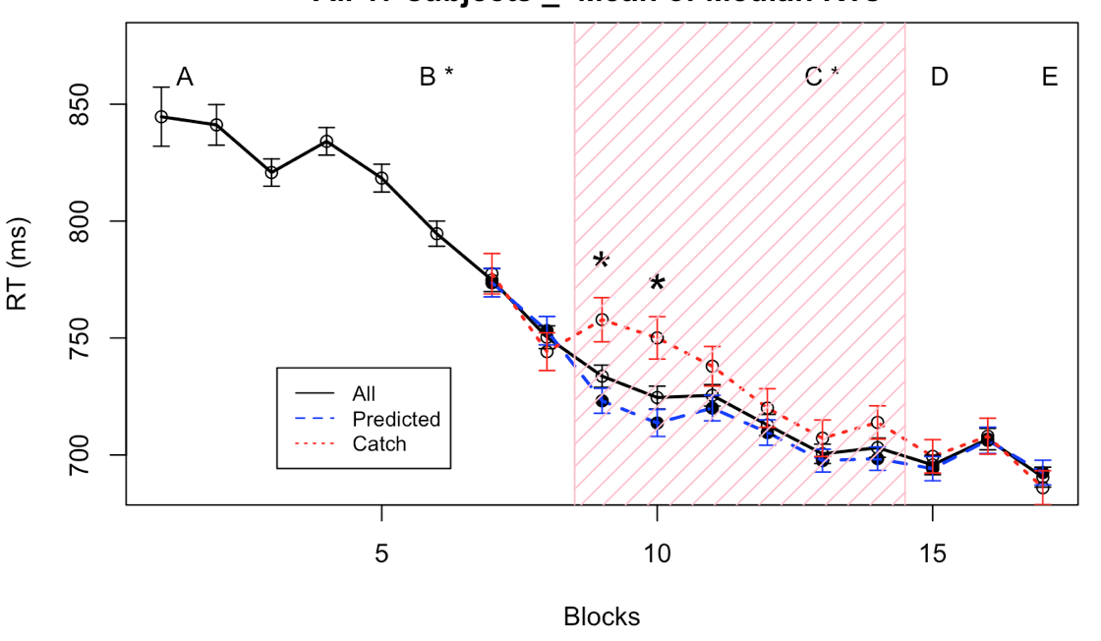
Experimental Test
YQ
QY
QY
XO
Maryam Zolfaghar
100 ms
Until response
maxWait: 3000 ms
YQ
QY
XO
RSI:
400 ms
QY
Time
100 ms

Slide 36
Central Hypotheses
Error-driven learning from diff between prediction and what happens next
Prediction – outcome cycle = 100ms = 10hz = alpha
Cortical deep layers drive prediction on Pulvinar
Layer 6CT neurons drive prediction
5IB (alpha burst) from lower layers drive outcome
Error is temporal diff, broadcast fm pulvinar
Local temporal-diff learning throughout cortex

Slide 37
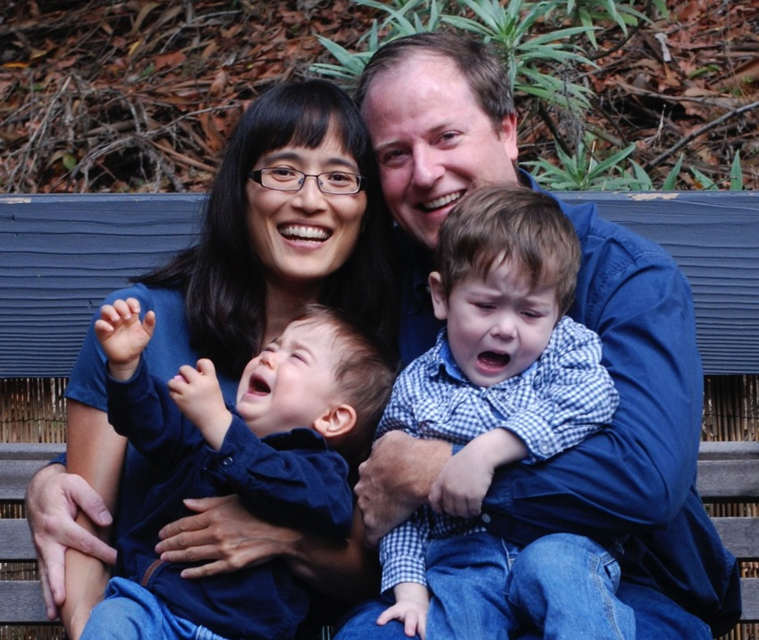
After Visual Learning..
Tantrums!!!
(Monster’s Inc. Scream Power)

Slide 38
Thanks To
CCN Lab
Will Chapman
Tom Hazy
Seth Herd
Kai Krueger
Jessica Mollick
Ananta Nair
John Rohrlich
Jake Russin
Dean Wyatte
Maryam Zolfaghar
Collaborators
Jonathan Cohen
Alex Petrov
Christian Lebiere
Tim Curran
Funding
ONR – Hawkins

Slide 39
Extras

Slide 40
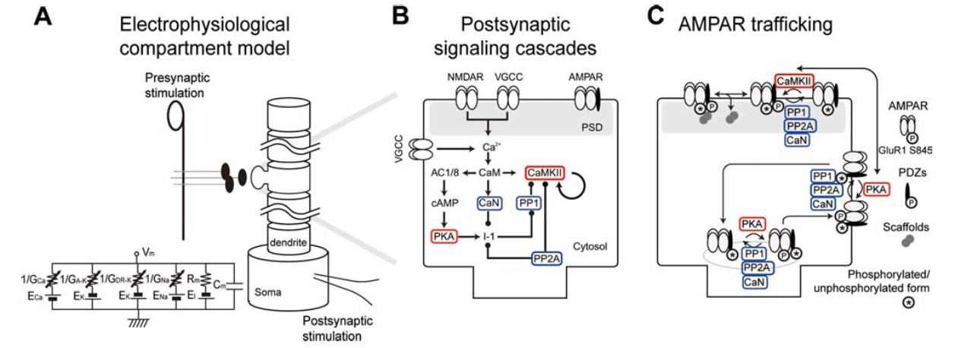
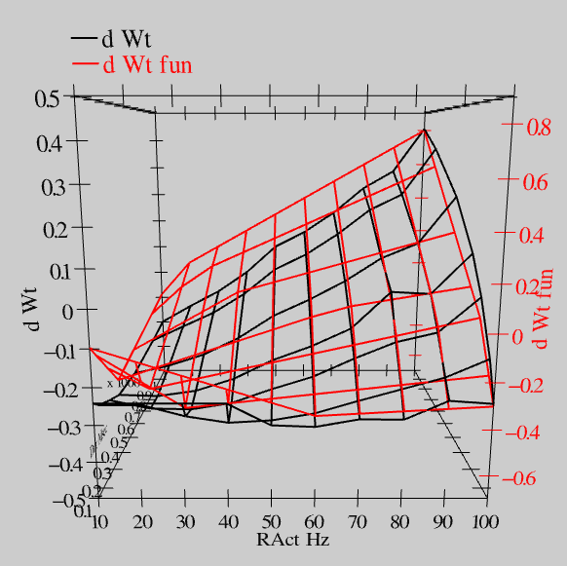
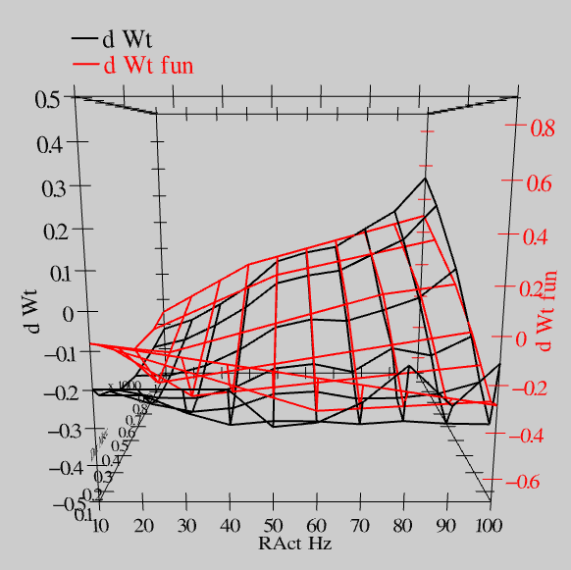
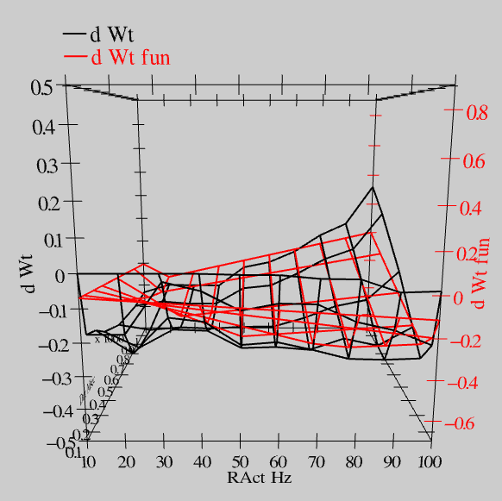
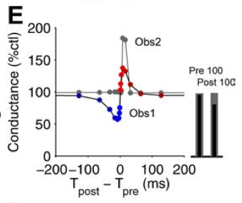
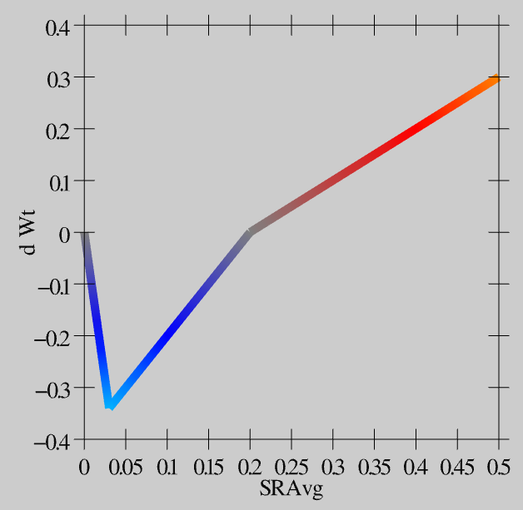
Synaptic Plasticity: XCAL Model (reduction of Urakubo et al, 2008 STDP model)
S = 100Hz
S = 50Hz
S = 20Hz
dW = f(send * recv) =
(spike rate * duration)
r=.894

Slide 41
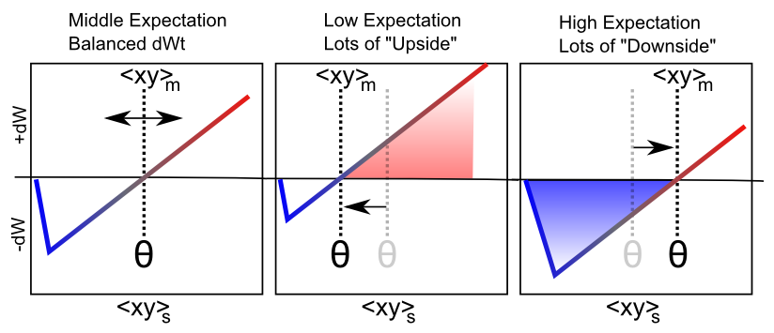
Floating Threshold = Medium Term Synaptic Activity (Error-Driven)
dW = Outcome – Expectation = <xy>_{s} - <xy>_{m}

Slide 42
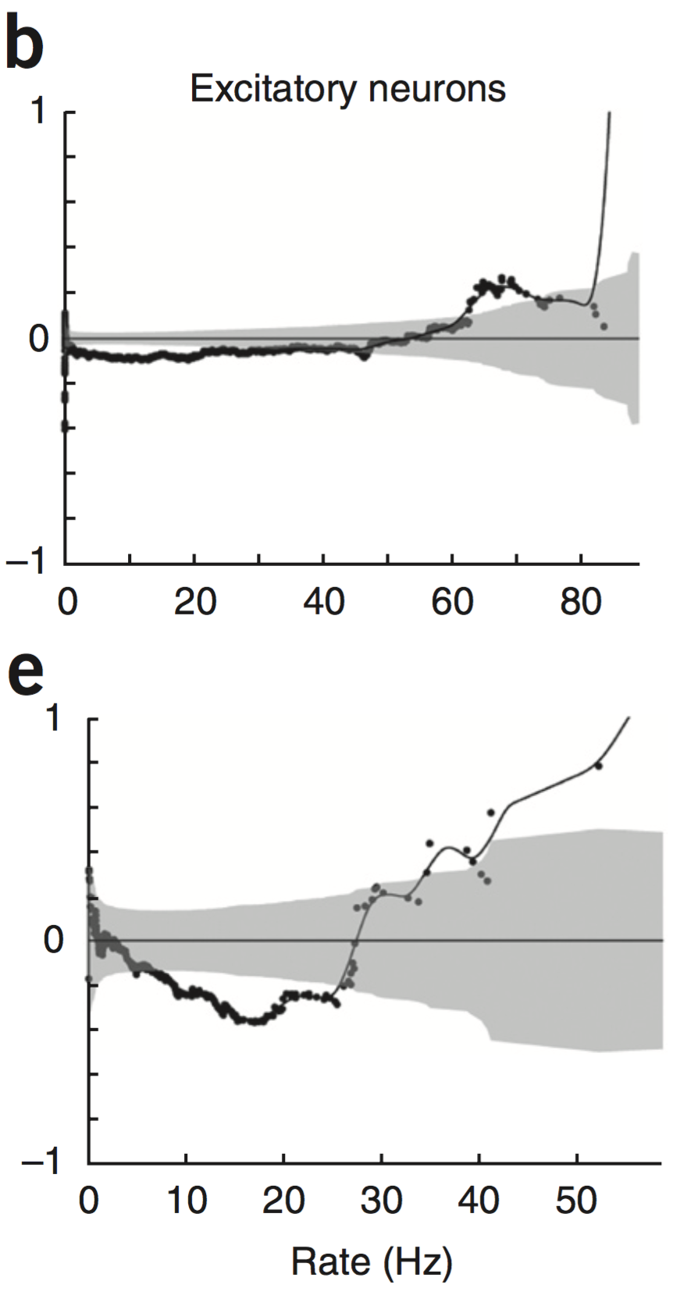
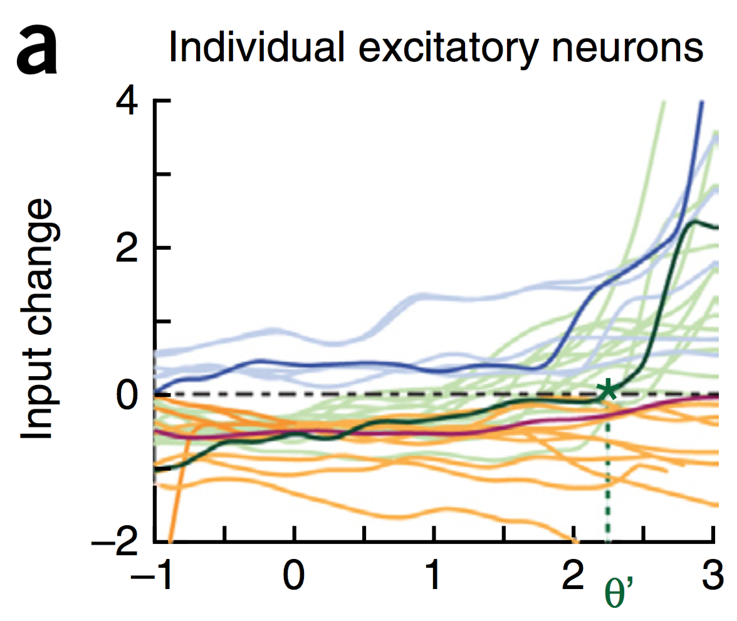
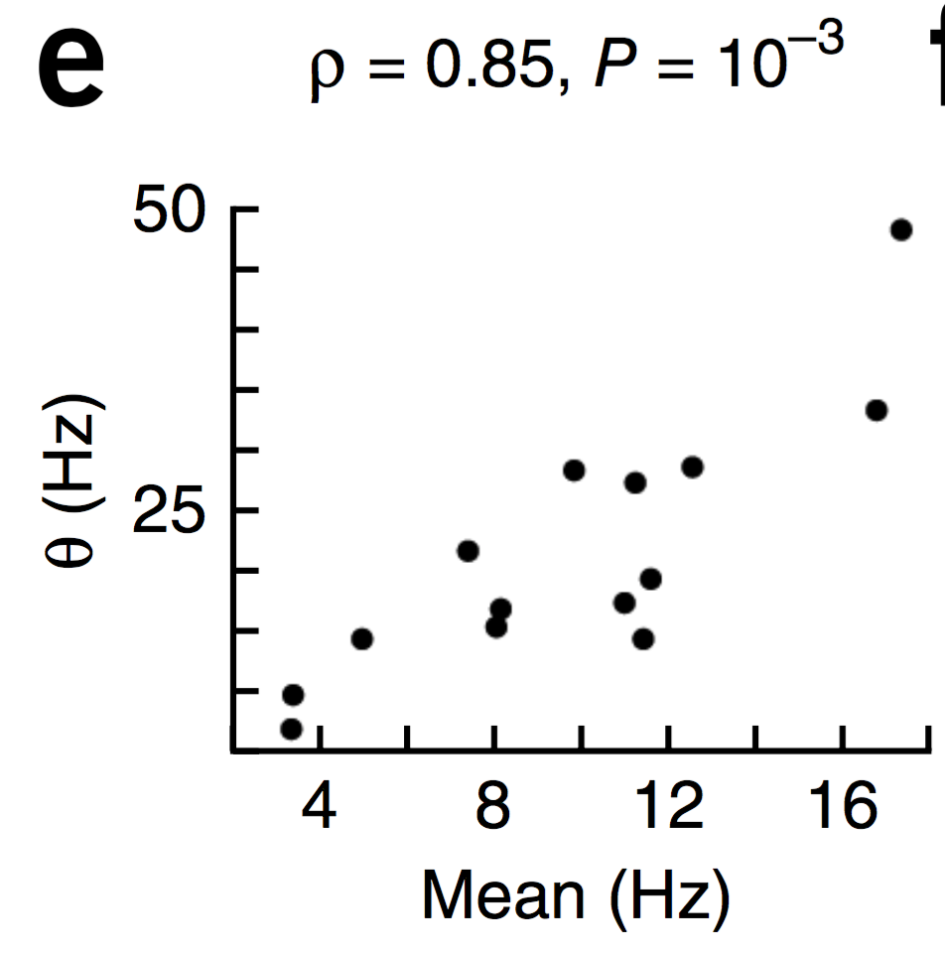
Evidence of Dynamic Thresholds (Lim, McKee, Woloszyn et al., 2015)
b = passive viewing
e = active task
Threshold changes dynamically on a rapid time scale, as a function of short-term activity level!

Slide 43
Catch 22

Slide 44
How can you learn high-level abstraction like “cat” without first learning about fur, paws, texture, color, shapes, edges...?

Slide 45
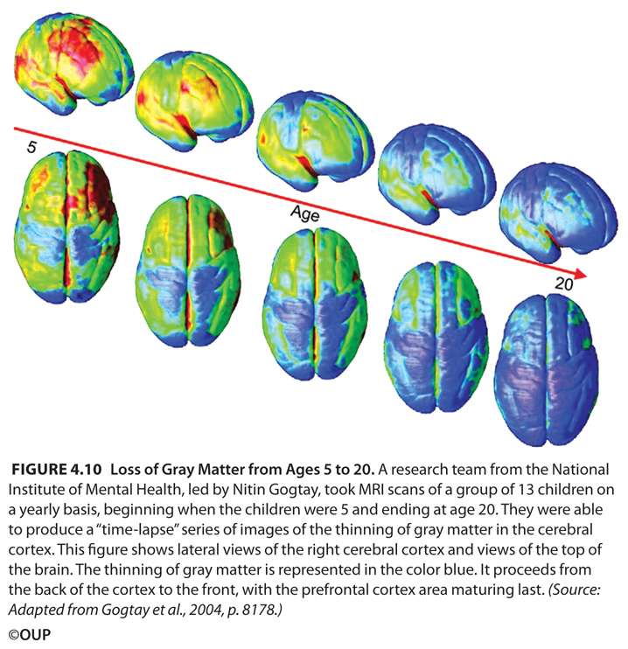
Bottom-up Development
Short-circuit the catch-22:
Progressively learn deeper layers:
each layer learns to encode / predict the one below it

Slide 46
Bottom-up Development
Short-circuit the catch-22:
Progressively learn deeper layers:
each layer learns to encode / predict the one below it

Slide 47
To Make IT Work:
1. Compact high-level representations (What, Where) needed for effective prediction at lowest levels:
Short-cut top-down projections
Earliest possible learning of abstractions
2. Shared “projection screen” where different visual pathways collaborate to create full prediction
Allows full prediction to be solved with separate, specialized pathways
3. Partition prediction error progressively, opportun-istically, to develop separable abstract pathways
Easy to develop abstract Where pathway – do this first!
Residual then concentrates What information
Also need What*Where binding pathway: V3, MT, DP?

Slide 48
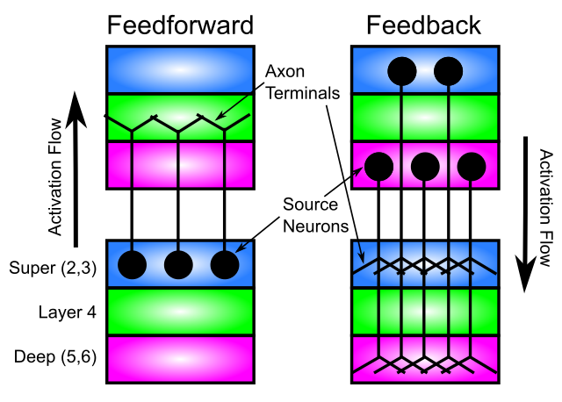
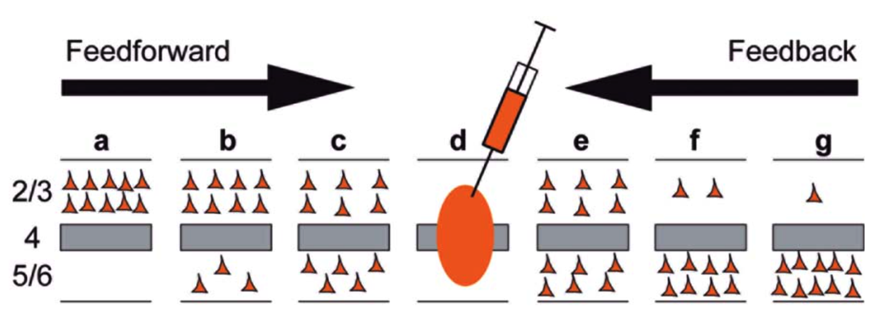
Key Connectivity Constraints
- Critical that feedforward does not project directly to deep layers:
This would short-circuit prediction process
(needs ”eyes closed” to predict)
- Deep feedforward not useful in our model, and rare in brain
- Deep feedback essential – dominates at longer distances

Slide 49
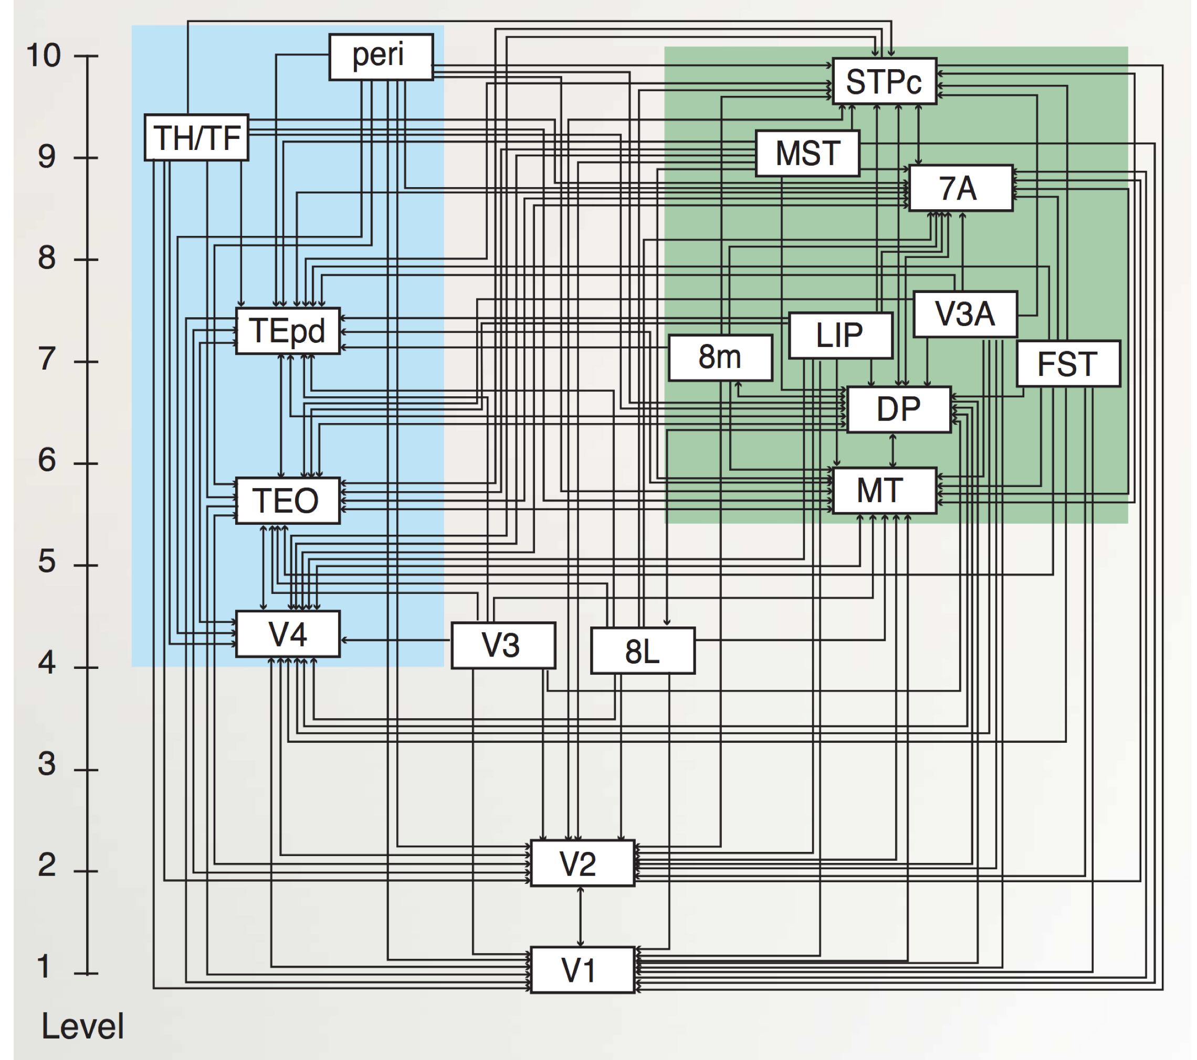
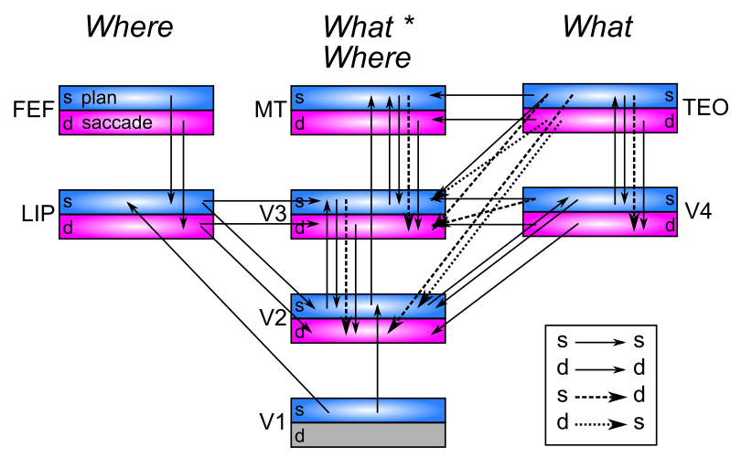
Pathway Interconnectivity
Markov et al, 2014
Extensive interconnectivity between areas – really pathways??
(Freud, Plaut, & Behrmann, 2016; de Haan & Cowey, 2011; Schenk & McIntosh, 2010..)
Dorsal has three pathways (Rizzolatti & Matelli, 2003; Kravitz et al., 2011; Haak & Beckmann, 2017)? MT particularly ambiguous (Milner & Goodale, 2006)

Slide 50
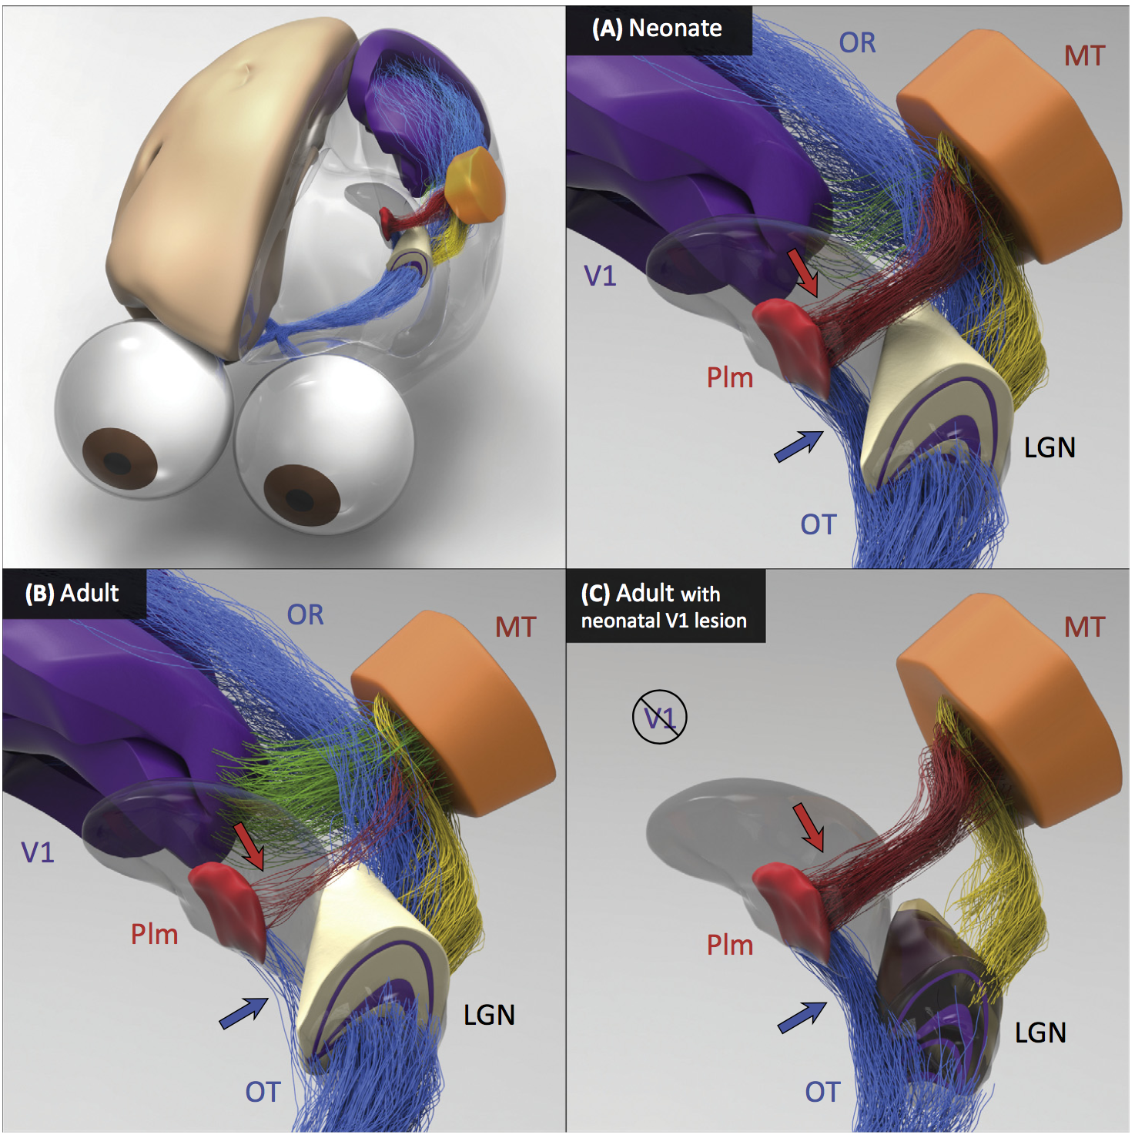
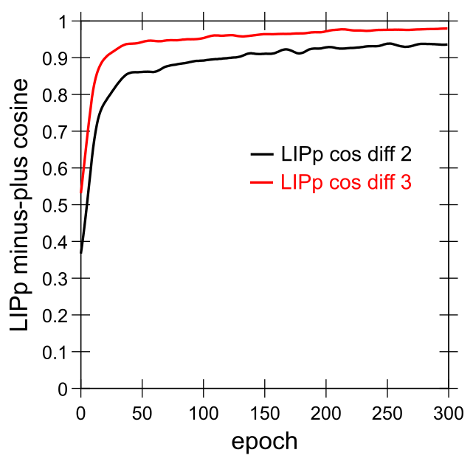
Early What Development
Bridge, Leopold, & Bourne, 2016:
Neonate: direct shortcut from LGN to Pim = Pulvinar which then trains MT and Where pathway
Adult: loses retinal shortcut, has more cortical (V1, etc) drive.
Model: quickly learns Where pathway into LIP, predicting object motion and saccades:

Slide 51
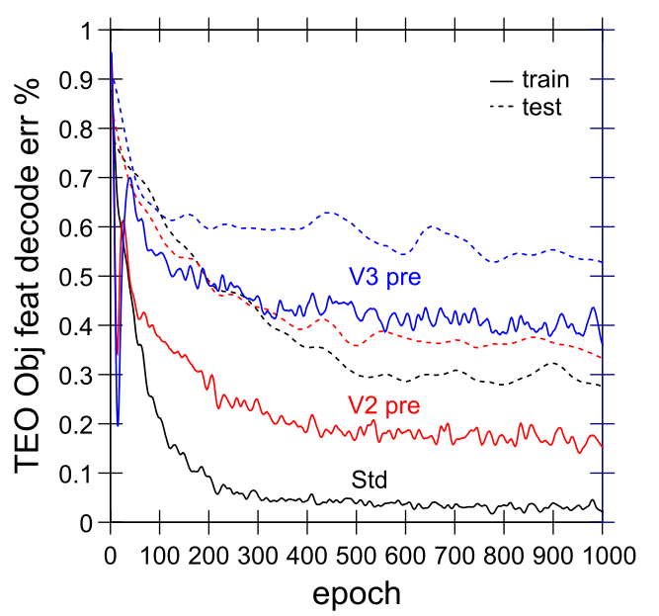
Progressive Bottom-up Not Good
- V2/3 pre = start with weights trained with V2/3 only
- Higher pretraining = worse performance!
- Need abstract, high-level areas shaping learning from the start

Slide 52
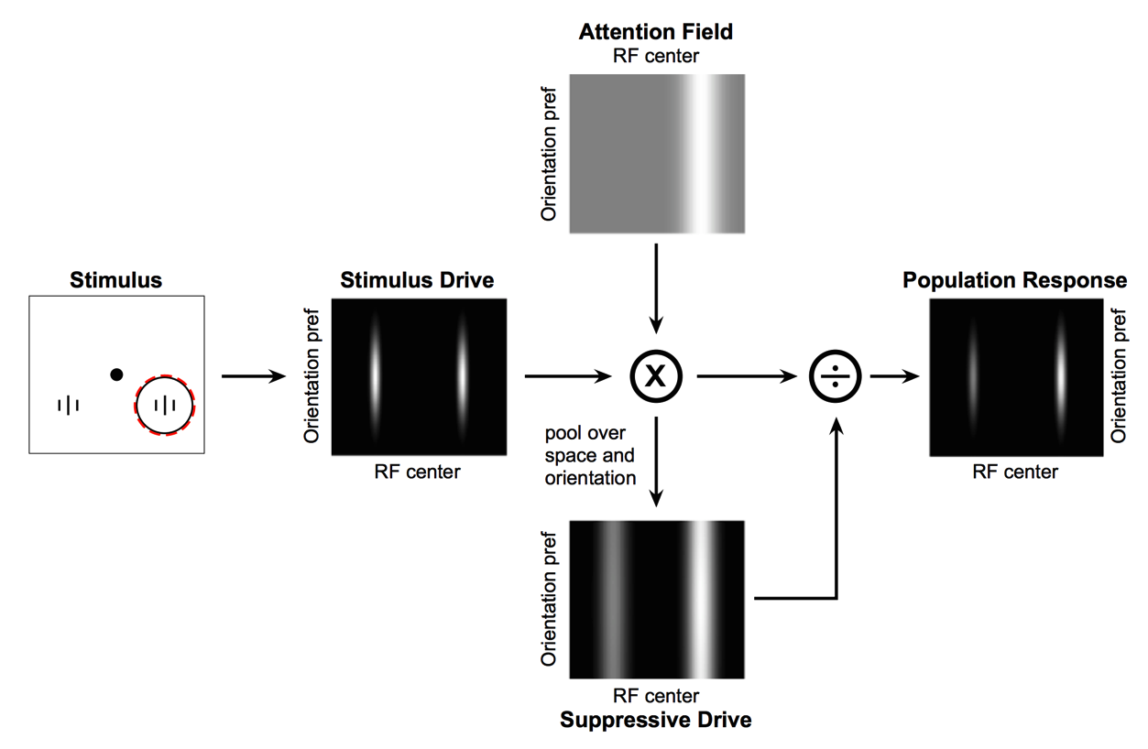
Deep Attentional Dynamics (Reynolds & Heeger, 2009; Grossberg, 1999)
Top-down deep layer
Attentional drive
Inputs to Layer 4
Layer 6 gain control
(Olsen, Bortone et al)

Slide 53
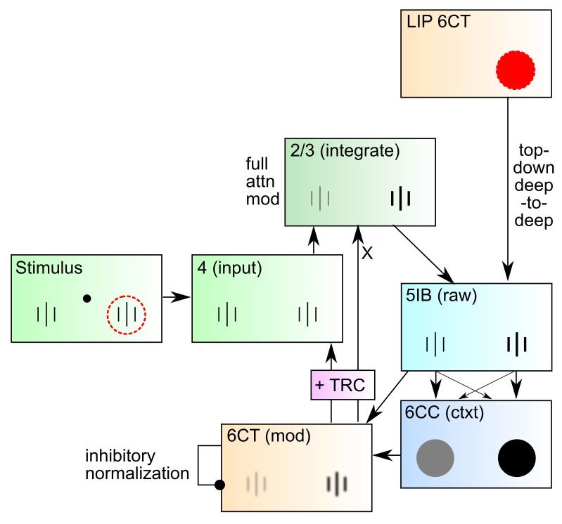
DeepLeabra Attentional Dynamics

Slide 54
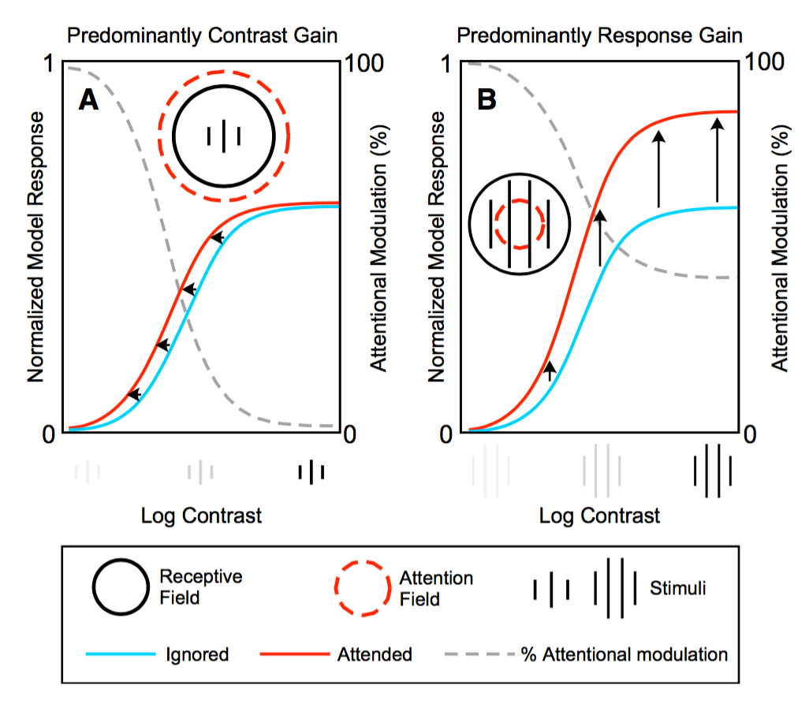
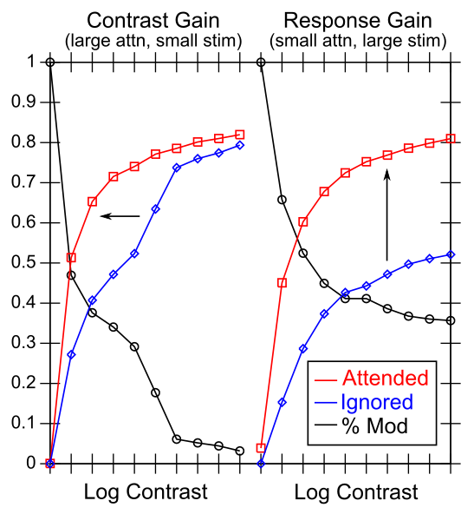
Attentional Dynamics Results

Slide 55
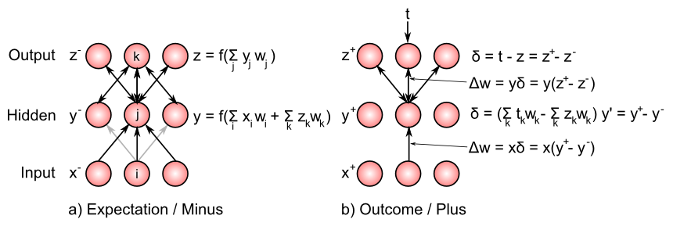
Bidirectional Connections Carry Error Gradients (GeneRec; O’Reilly, 1996)
dW = x⁺y⁺ - x⁻y⁻
(Midpoint integration + symmetry = Contrastive Hebbian = DBM)

Slide 56

Activation Diffs Implicitly Compute Derivatives (GeneRec; O’Reilly, 1996)
Free to use arbitrarily complex activation functions!

Slide 57

Key Prediction: Full Processing Requires 2 Alpha Cycles
First alpha cycle = bottom-up processing of new input without established prediction
Second cycle = deep-layer prediction (generative model of scene) contrasts with second wave of bottom-up processing, differences drive learning
Predictions: saccade duration = 2 alpha cycles; novel vs. familiar emerges in 2nd alpha cycle

Slide 58


Data from David Sheinberg, Tim Curran’s labs Consistent with predictions from model
Super
Layers
(2 cyc,
nov vs
fam 2nd only)
Deep
Layers
(2nd cyc
only)
Left: super vs. deep local field potential in monkey IT cortex, showing 2 alpha-frequency waves in superficial layers, 1 in deep layers, with familiar vs. novel differences emerging in 2nd alpha cycle.
Right: fixation duration for humans in free viewing of complex scenes, with strong 200msec peak predicted by model (2 alpha cycles)

Slide 59

Saccade Resets Alpha (Zolfaghar, Devillez, Curran et al, in prep)
fixation onset
synchronized alpha

Slide 60






Simultaneous V4 and IT Recording (Guan & Sheinberg, in prep)
Spike waveforms

Slide 61
IT Encodes Familiarity First
Despite having slower onset, IT encodes familiarity before V4
} novel
} familiar
PSTH
significance
onset
offset

